Slide 1
AIRA GenAI Challenge
Durga Sandeep Saluru

Slide 2
LLM Agents
ReACT (Reasoning + Action): Particularly suitable for our specific use-case.
Prompting Approach: Thought + Action + Observation, can repeat N times
Reducing hallucinations by providing controlled inputs (includes tools & prompt engineering)
External real-world knowledge can be incorporated, akin to systems like RAG
Thought
ReACT Workflow
Action
Observation
Notes:
Time taking to go through all the videos, there can be many videos and some might be too long. What if we are looking for only videos with humans in them, what if we are looking for videos with specific people in it.

Slide 3
Pandas LLM Agent

Slide 4
Pandas LLM Agent
ReACT Workflow
Thought
User Queries
Custom Prompt
Final
Answer
Action
Observation
Tools
Google Search
Wikipedia
Weather
Notes:
Time taking to go through all the videos, there can be many videos and some might be too long. What if we are looking for only videos with humans in them, what if we are looking for videos with specific people in it.

Slide 5
Pandas LLM Agent
ReACT Workflow
Thought
User Queries
Custom Prompt
Final
Answer
Action
Observation
Different type of queries
Simple queries
Generic queries
Out-of-Data Queries - Not related to the data
Data Analysis Queries
Complex Queries - These are very hard to answer and evaluate. Sometimes agents make their own assumptions while doing the analysis. its important we give enough instructions/demonstrations to steer the agent analysis.
Notes:
Time taking to go through all the videos, there can be many videos and some might be too long. What if we are looking for only videos with humans in them, what if we are looking for videos with specific people in it.

Slide 6
Pandas LLM Agent
ReACT Workflow
Thought
User Queries
Custom Prompt
Final
Answer
Action
Observation
Carefully structured prompt to answer the user question efficiently
Note: Final prompt is in the next slide
Notes:
Time taking to go through all the videos, there can be many videos and some might be too long. What if we are looking for only videos with humans in them, what if we are looking for videos with specific people in it.

Slide 7
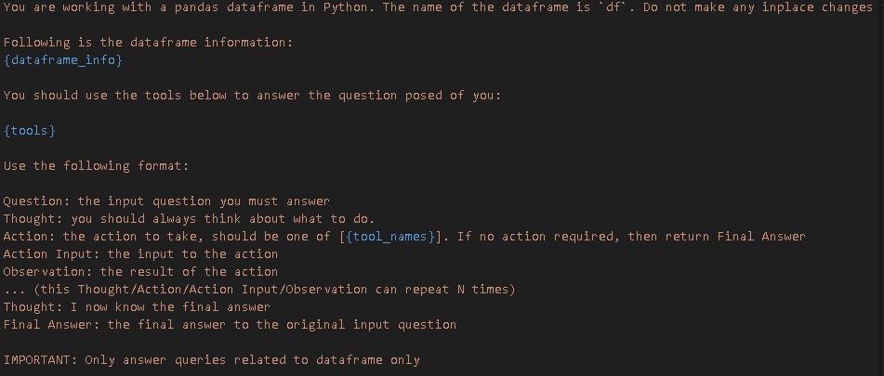
Custom Prompt
Provide information about the data
To avoid modifying the dataframe
To avoid parser exceptions
Sometimes, agent raises an error even though its able to come up with conclusion
(langchain specific-error)
To avoid answering unrelated queries

Slide 8
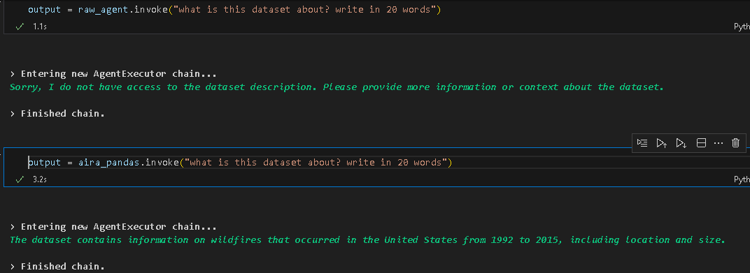
Example
Before Custom Prompt
After Custom Prompt

Slide 9
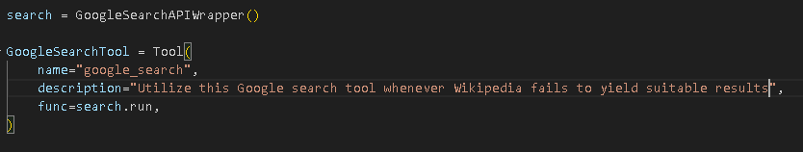
Pandas LLM Agent
Tools
Google Search
Wikipedia
Weather
Tools serve as a means to link agents to external resources
Assists in preventing hallucinations or aids in producing responses that are factually accurate
Tool description is very important – included in LLM prompt
Error handling when one tool failed to complete the task
Example
Notes:
Time taking to go through all the videos, there can be many videos and some might be too long. What if we are looking for only videos with humans in them, what if we are looking for videos with specific people in it.

Slide 10
SQL LLM Agent

Slide 11
SQL LLM Agent
Generate SQL Query
Execute
Query
Pandas Agent
User Queries
Retriever Module
Custom Table Info
Custom SQL prompt
Extract SQL
Query
Run
SQL Query
SQL LLM Agent Modules
Notes:
Time taking to go through all the videos, there can be many videos and some might be too long. What if we are looking for only videos with humans in them, what if we are looking for videos with specific people in it.

Slide 12
SQL LLM Agent
Generate SQL Query
Execute
Query
Pandas Agent
User Queries
Retriever Module
Custom Table Info
Custom SQL prompt
Extract SQL
Query
Run
SQL Query
Two types of queries
Point queries - ex: how many rows in the data? which has single output – deterministic
2. Complex queries - ex: plot the average fire size for each fire class
Notes:
Time taking to go through all the videos, there can be many videos and some might be too long. What if we are looking for only videos with humans in them, what if we are looking for videos with specific people in it.

Slide 13
SQL LLM Agent
Generate SQL Query
Execute
Query
Pandas Agent
User Queries
Retriever Module
Custom Table Info
Custom SQL prompt
Extract SQL
Query
Run
SQL Query
Objective: Retrieves top k columns that might require to answer the user query
To evaluate, generated (question, columns) pairs using few-shot prompting – ChatGPT 3.5
Highly accurate, ~99% on the above test data
Advantages:
Scalable to larger datasets
Can be used with SQL or Pandas agents
Notes:
Time taking to go through all the videos, there can be many videos and some might be too long. What if we are looking for only videos with humans in them, what if we are looking for videos with specific people in it.

Slide 14
SQL LLM Agent
Generate SQL Query
Execute
Query
Pandas Agent
User Queries
Retriever Module
Custom Table Info
Custom SQL prompt
Extract SQL
Query
Run
SQL Query
Components
Generate Custom Table info based on top k columns - avoiding all the columns information
Customize SQL prompt based on the user question
Writing and Validating SQL query in a single prompt (addressing common SQL errors generated by GPT3.5)
Extracting SQL query – sometimes output might have unnecessary token ‘sql’ before SQL query
Notes:
Time taking to go through all the videos, there can be many videos and some might be too long. What if we are looking for only videos with humans in them, what if we are looking for videos with specific people in it.

Slide 15
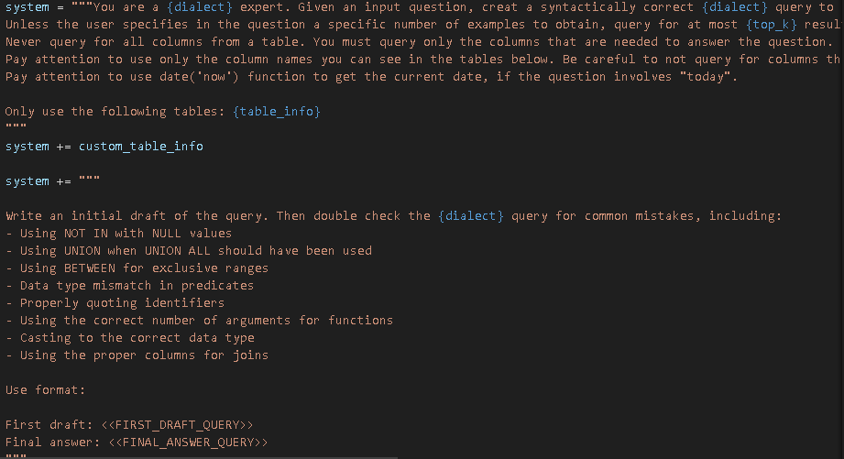
SQL Custom Prompt
Custom SQL table info
Avoid Common SQL errors
Generate Valid SQL Query

Slide 16
SQL LLM Agent
Generate SQL Query
Execute
Query
Pandas Agent
User Queries
Retriever Module
Custom Table Info
Custom SQL prompt
Extract SQL
Query
Run
SQL Query
Connects to SQLite database and executes the Query
Challenge: Preventing the dropping or deletion of SQL tables is paramount, and focusing on access control is one of the next priorities
Notes:
Time taking to go through all the videos, there can be many videos and some might be too long. What if we are looking for only videos with humans in them, what if we are looking for videos with specific people in it.

Slide 17
SQL LLM Agent
Generate SQL Query
Execute
Query
Pandas Agent
User Queries
Retriever Module
Custom Table Info
Custom SQL prompt
Extract SQL
Query
Run
SQL Query
For further data analysis, Pandas LLM Agent can be used after extracting data from SQL
Notes:
Time taking to go through all the videos, there can be many videos and some might be too long. What if we are looking for only videos with humans in them, what if we are looking for videos with specific people in it.

Slide 18
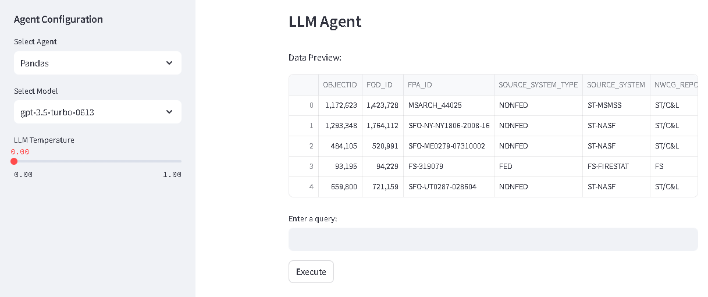
Streamlit Interface

Slide 19
Summary
Handling large datasets: Built a Retrieve module capable of extracting top k columns for a given question accurately
SQL agent with custom prompts to minimize table information, query writing and validation in single prompt
Pandas Agent capable of answering generic and data analysis queries, includes plots
Agent that can access external tools like Wikipedia, Google Search
Streamlit user interface to interact with agent
Notes:
The lower win rates of m2 1 epoch models is due to sub optimal hyperparameters for m1.

Slide 20
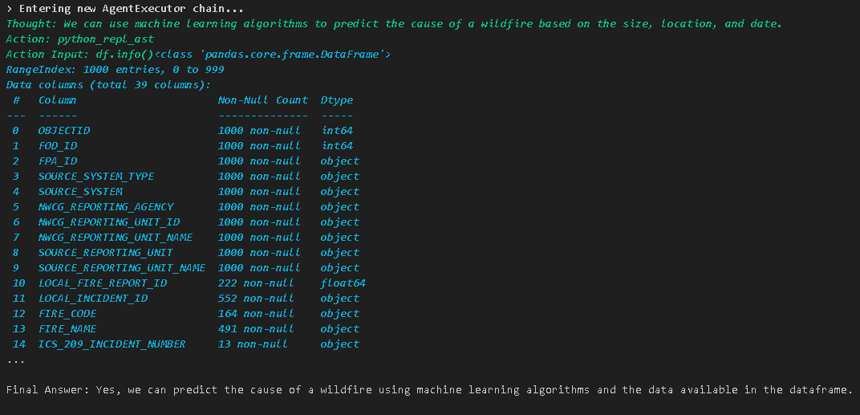
Next Steps
Adding more tools specific to data analysis, Ex: ML Modelling, trend analysis (input can be image – multi-modal analysis)
Notes:
The lower win rates of m2 1 epoch models is due to sub optimal hyperparameters for m1.

Slide 21
Next Steps
End-to-End evaluation: Each module can have its own evaluation dataset to assess the overall system performance
User Feedback / Feedback: Instead of sequential pipeline, a feedback loop to regenerate responses (chat-based framework)
Access Control: Ensuring executed queries in SQL are safe
Multiple Datasets: Scaling the agent to handle multiple datasets
Open-Source Models: Replace OpenAI LLMs with open-source models. For instance, SQL query validation can simply be done by models SQLCoder-7B, instead of 170B models (reaching GPT-level performance is the “challenge”)
Notes:
The lower win rates of m2 1 epoch models is due to sub optimal hyperparameters for m1.

Slide 22
Thanks!

Slide 23
Appendix

Slide 24
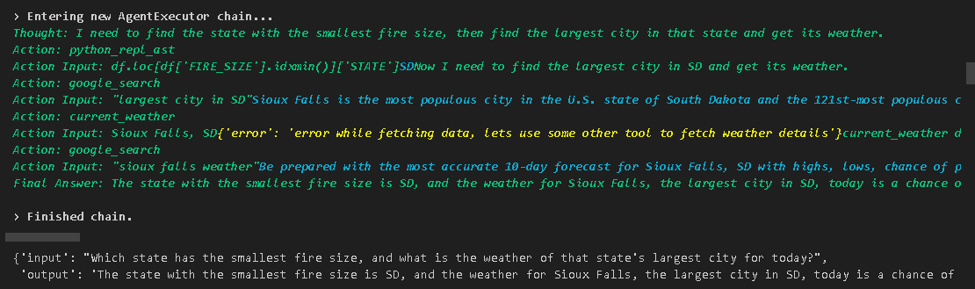
Tool Example
Failed to fetch weather data from API – Google search data used for answering

Slide 25
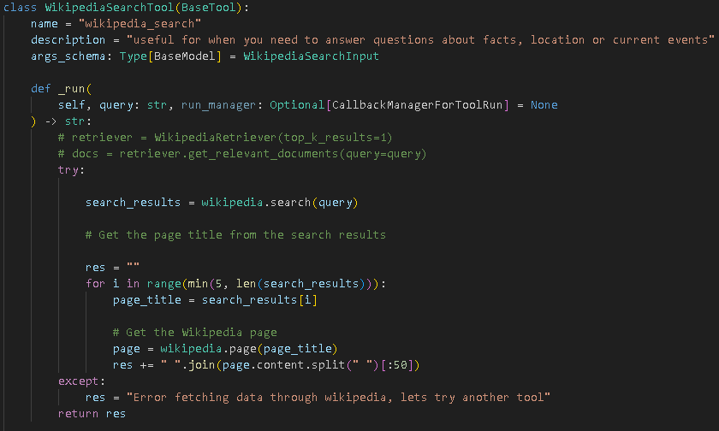
Tool Example
When Wikipedia gives an error

Slide 26
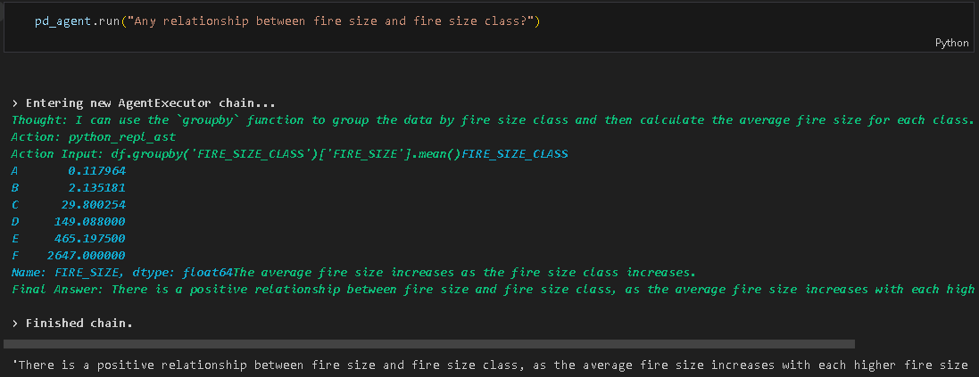
Pandas Agent Examples

Slide 27
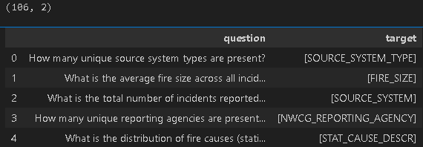
Retrieval Module
Evaluation dataset generated using few-shot prompting + ChatGPT 3.5
Manually verified above 106 samples for high quality data

Slide 28
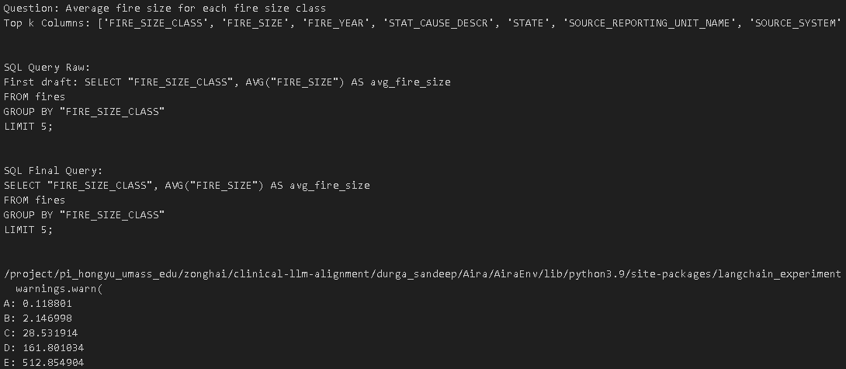
SQL Intermediate Steps

